Slide 1
WEB ENGINEERING

Slide 2
Web Engineering
It is a multidisciplinary field that focuses on the systematic development, design, implementation, testing, and maintenance of web-based applications.
Why multidisciplinary?
Goal: It ensures creation of robust, scalable, secure, and maintainable web solutions.

Slide 3
Web Programming
Concentrates on the development phase, using languages like HTML, CSS, JavaScript, and backend languages (e.g., Python, PHP).
Tasks: Includes tasks like front-end and back-end development, coding for databases, and implementing user interactions.
Objective: To develop functional and interactive web applications or websites.

Slide 4
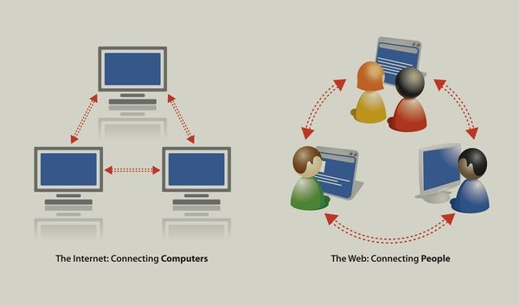
World Wide Web
WWW stands for World Wide Web, which is a system of interconnected web pages that are accessible to the public over the internet.
Is there any difference between World Wide Web and Internet?????

Slide 5
Web Browser
Software application that allows users to access, retrieve, and display content from the World Wide Web.
Components:
Rendering Engine: Interprets HTML, CSS, and JavaScript, and renders the web page's content on the screen.
JavaScript Engine: Executes JavaScript code to make web pages interactive.

Slide 6
Web server
A web server is a software or hardware system that hosts websites and serves web pages to users upon request.
Web servers can serve static as well as dynamic contents.

Slide 7
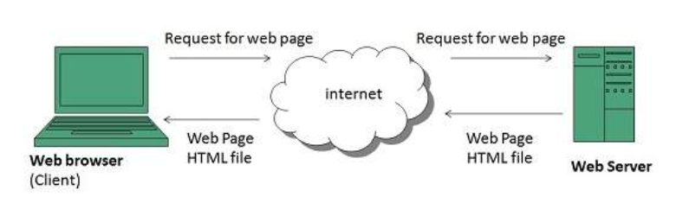
Working of WWW
WWW works on client- server approach.

Slide 8
URI, URL, and URN
URI (Uniform Resource Identifier): A generic term for identifying a resource, either by location, name, or both. It can be a URL or a URN.
URL (Uniform Resource Locator): A type of URI that specifies the location of a resource on the internet and the protocol used to access it.
URN (Uniform Resource Name): A type of URI that identifies a resource by name in a namespace, but does not specify its location.
Example: urn:isbn:0451450523
Example: http://www.example.com/page.html
Example: urn:isbn:0451450523

Slide 9
URL Types
Absolute URL
It is a complete address of a resource on the web. This completed address comprises of protocol used, server name, path name and file name.
For example http:// www.example.com / internet_technology /index.html.
2. Relative URL
Relative URL is a partial address of a webpage. Unlike absolute URL, the protocol and server part are omitted from relative URL.
For example, to link an image on http:// www.example.com / internet_technology/internet_reference_models
Relative URL - /internet_technologies/internet-osi_model.jpg.

Slide 10
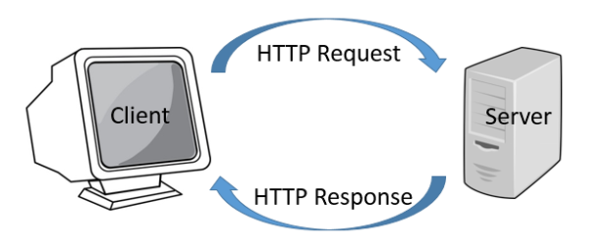
HTTP
As a request-response protocol, HTTP gives users a way to interact with web resources such as HTML files by transmitting hypertext messages between clients and servers.
HTTP clients generally use Transmission Control Protocol (TCP) connections to communicate with servers.

Slide 11
HTTP Request-Response Cycle
The client initiates a request to the server by sending an HTTP request message, which contains information such as the requested resource and any additional parameters.
The server receives the request message and processes it, using its resources to generate a response message.
The server sends the response message back to the client, which typically contains the requested resource (such as a web page) and any additional information or metadata.
The client receives the response message and processes it, usually by rendering the content in a web browser.
The client may initiate additional requests to the server, repeating the cycle as needed.

Slide 12
HTTP Request Methods
GET requests a specific resource in its entirety
HEAD requests a specific resource without the body content
POST adds content, messages, or data to a new page under an existing web resource
PUT directly modifies an existing web resource or creates a new URI if need be
DELETE gets rid of a specified resource
TRACE shows users any changes or additions made to a web resource
OPTIONS shows users which HTTP methods are available for a specific URL
CONNECT converts the request connection to a transparent TCP/IP tunnel
PATCH partially modifies a web resource

Slide 13
HTTP flow
Open a TCP connection: The TCP connection is used to send a request, or several, and receive an answer. The client may open a new connection, reuse an existing connection, or open several TCP connections to the servers.
Send an HTTP message: HTTP messages (before HTTP/2) are human-readable. With HTTP/2, these simple messages are encapsulated in frames, making them impossible to read directly, but the principle remains the same. For example:
GET / HTTP/1.1
Host: developer.example.org
Accept-Language: fr

Slide 14
3. Read the response sent by the server, such as:
HTTP/1.1 200 OK
Date: Sat, 09 Oct 2010 14:28:02 GMT
Server: Apache
Last-Modified: Tue, 01 Dec 2009 20:18:22 GMT
ETag: "51142bc1-7449-479b075b2891b"
Accept-Ranges: bytes
Content-Length: 29769
Content-Type: text/html
4. Close or reuse the connection for further requests.

Slide 15
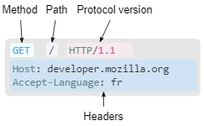
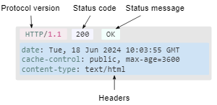
HTTP Request HTTP Response

Slide 16
Simple Mail Transfer Protocol (SMTP)
SMTP connection opened: Since SMTP uses the Transmission Control Protocol (TCP) as its transport protocol, this first step begins with a TCP connection between client and server. Next, the email client begins the email sending process with a specialized "Hello" command.
Email data transferred: The client sends the server a series of commands accompanied with the actual content of the email: the email header (including its destination and subject line), the email body, and any additional components.
Mail Transfer Agent (MTA): The server runs a program called a Mail Transfer Agent (MTA). The MTA checks the domain of the recipient's email address, and if it differs from the sender's, it queries the Domain Name System (DNS) to find the recipient's IP address. This is like a post office looking up a mail recipient's zip code.
Connection closed: The client alerts the server when transmission of data is complete, and the server closes the connection. At this point the server will not receive additional email data from the client unless the client opens a new SMTP connection.

Slide 17
SMTP commands
HELO: These commands say "Hello" and start off the SMTP connection between client and server.
MAIL FROM: This tells the server who is sending the email. If Alice were trying to email her friend Bob, a client might send
"MAIL FROM:<alice@example.com>".
RCPT TO: This command is for listing the email's recipients. A client can send this command multiple times if there are multiple recipients. In the example above, Alice's email client would send
"RCPT TO:<bob@example.com>".

Slide 18
DATA: This precedes the content of the email, like:
DATA
Date: Mon, 4 April 2022
From: Alice alice@example.com
Subject: Eggs benedict casserole
To: Bob bob@example.com
Hi Bob,
I will bring the eggs benedict casserole recipe on Friday.
-Alice
.

Slide 19
RSET: This command resets the connection, removing all previously transferred information without closing the SMTP connection. RSET is used if the client sends incorrect information.
QUIT: This ends the connection.

Slide 20
What is an SMTP server?
An SMTP server is a mail server that can send and receive emails using the SMTP protocol. Email clients connect directly with the email provider's SMTP server to begin sending an email. Several different software programs run on an SMTP server:
Mail submission agent (MSA): The MSA receives emails from the email client.
Mail transfer agent (MTA): The MTA transfers emails to the next server in the delivery chain. It may query the DNS to find the recipient domain's mail exchange (MX) DNS record if necessary.
Mail delivery agent (MDA): The MDA receives emails from MTAs and stores them in the recipient's email inbox.

Slide 21
What port does SMTP use?
Port 25 is most used for connections between SMTP servers. Firewalls for end user networks often block this port today, since spammers try to abuse it to send large amounts of spam.
Port 465 was once designated for use by SMTP with Secure Sockets Layer (SSL) encryption. But SSL was replaced by Transport Layer Security (TLS), and modern email systems therefore do not use this port. It only appears in legacy (outdated) systems.
Port 587 is now the default port for email submission. SMTP communications via this port use TLS encryption.
Port 2525 is not officially associated with SMTP, but some email services offer SMTP delivery over this port in case the above ports are blocked.

Slide 22
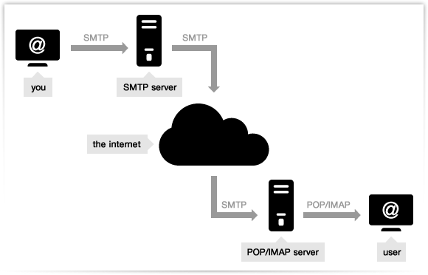
Working of SMTP server

Slide 23
Internet Service Provider
Tier 1 ISPs: These ISPs have the largest global reach and own sufficient network lines to transmit most traffic independently. They do not pay anyone for the internet but invest heavily in setting up the infrastructure.
Tier 2 ISPs: These ISPs have a country or region-wide reach and connect tier 1 and tier 3 ISPs as service providers. They pay for internet access to tier 1 networks, but also partner with other tier 2 ISPs for bandwidth exchange.
Tier 3 ISPs: These ISPs link end-users to the internet via the network of another ISP they rely on and pay higher-tier ISPs for internet service access. They are primarily concerned with providing Internet connections to local businesses and consumer markets.

Slide 24
Hyperlink
A hyperlink, sometimes referred to as a link, is a reference that connects two resources. It has an element that may be clicked, such as a symbol, text, phrase, or picture.
Examples:

Slide 25
Domain Name System
Domain names are used for naming websites and email addresses.
The Domain Name System or DNS overcomes the problem of remembering IP addresses by mapping domain names to IP addresses.
The DNS is a distributed database across a hierarchy of networks of servers and provide ways for devices and software (like browsers and email) to query the DNS to get an IP address.
Domain names must be unique.

Slide 26
DNS cont’d…
Each Top Level Domain (TLD) is managed by a specific organization called a Registry Operator under contract with ICANN.
Top Level Domains (TLDs) are divided into two types;
generic Top Level Domains (gTLDs)
country code Top Level Domains (ccTLDs)
The second level domain is the part that you register which is used to provide online systems such as websites and emails.
Domains are sold by a large number of registrars and resellers who do so under contract with registrars.

Slide 27
DNS Examples
1. Generic Top-Level Domain names
Examples: Com, Edu, Gov, Int, Mil, Net, Org
2. Country top-level domain names
Examples: au, in, jp, de, ca, hk, es
Types of Name Servers
Root Server is the top level server which consists of the entire DNS tree. It does not contain the information about domains but delegates the authority to the other server.
Primary Server stores a file about its zone. It has authority to create, maintain, and update the zone file.
Secondary Server transfers complete information about a zone from another server which may be primary or secondary server. The secondary server does not have authority to create or update a zone file.

Slide 28
DNS Working
What happens when I type www.example.com in my browser?
The domain name lookup process;
1. You type "www.example.com" into your browser's address bar.
2. The DNS server queries the "root servers" for the information. The root zone only knows information about the zones they are responsible for which is the Top Level Domains (TLDs). There are 13 root servers which have copies distributed around the world.
3. The root server will refer the DNS server to the “.com" TLD nameservers. The TLD Name servers knows information of all second level domains under their zone.
4. The Top Level Domain Name servers will refer us to the DNS servers responsible for "example.com"
5. The DNS servers authoritative for example.com will give us the IP address for www.example.com” and the web resource is displayed..

Slide 29
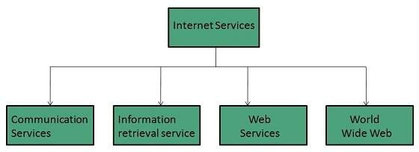
Internet based services

Slide 30
Communication Services
1. Electronic Mail - Used to send electronic message over the internet.
2. Telnet - Used to log on to a remote computer that is attached to internet.
3. Newsgroup - Offers a forum for people to discuss topics of common interests.
4. Internet Relay Chat (IRC) - Allows the people from all over the world to communicate in real time.
5. Mailing Lists - Used to organize group of internet users to share common information through e-mail.
6. Internet Telephony (VoIP) - Allows the internet users to talk across internet to any PC equipped to receive the call.
7. Instant Messaging - Offers real time chat between individuals and group of people. Eg. Yahoo messenger.

Slide 31
Information Retrieval Services
1. File Transfer Protocol (FTP) - Enable the users to transfer files.
2. Archie - It’s updated database of public FTP sites and their content. It helps to search a file by its name.
3. Gopher - Used to search, retrieve, and display documents on remote sites.
4. Very Easy Rodent Oriented Netwide Index to Computer Achieved (VERONICA) - VERONICA is gopher based resource. It allows access to the information resource stored on gopher’s servers.

Slide 32
Web services allow exchange of information between applications on the web.
1. XML-RPC (Remote Procedure Call) is the most basic XML protocol to exchange data between a wide variety of devices on a network. It uses HTTP to quickly and easily transfer data and communication other information from client to server.
2. UDDI (Universal Description, Discovery, and Integration) is an XML-based standard for detailing, publishing, and discovering web services. It’s basically an internet registry for businesses around the world. The goal is to streamline digital transactions and e-commerce among company systems.

Slide 33
3. SOAP is an XML-based Web service protocol to exchange data and documents over HTTP or SMTP. It allows independent processes operating on disparate systems to communicate using XML.
4. REST provides communication and connectivity between devices and the internet for API-based tasks. Most RESTful services use HTTP as the supporting protocol.
WWW is also known as W3. It offers a way to access documents spread over the several servers over the internet. These documents may contain texts, graphics, audio, video, hyperlinks. The hyperlinks allow the users to navigate between the documents.

Slide 34
JavaScript
JavaScript is a programming language used to create dynamic content for websites. It is a lightweight, cross-platform, and single-threaded programming language.
HTML adds Structure to a web page, CSS styles it and JavaScript brings it to life by allowing users to interact with elements on the page, such as actions on clicking buttons, filling out forms, and showing animations.
JavaScript on the client side is directly executed in the user's browser. Almost all browsers have JavaScript Interpreter and do not need to install any software. There is also a browser console where you can test your JavaScript code.
JavaScript is also used on the Server side (on Web Servers) to access databases, file handling and security features to send responses, to browsers.

